Slide 1

Team Members: Will Enowmbitang Sampras Kajal Dave Nidhi Bharatkumar Aryan Reddy

Slide 2
Apple tv
Apple TV+ is a subscription-based streaming service launched by Apple Inc. in November 2019. It focuses on producing high-quality, original content, including TV shows and movies. The service aims to provide a premium viewing experience with a curated selection of exclusive content.

Slide 3

Market overview
The streaming industry is highly competitive, with major players like Netflix, Amazon Prime Video, Hulu, and Disney+. These services offer a wide range of content, including original productions and licensed content from various studios and networks.
The industry is characterized by rapid growth, with increasing demand for diverse and engaging content.

Slide 4
Problem statement
Despite investing heavily in original content, Apple TV+ faces challenges in attracting and retaining subscribers. The service has not seen significant growth in viewership, with only 0.2% of total TV viewing in the U.S. and high churn rates compared to competitors

Slide 5
Perceptual mapping
To address this issue, we will use perceptual mapping to understand how consumers perceive Apple TV+ in relation to its competitors. This will help identify gaps in the market and opportunities for differentiation.
Key Questions to Answer:
How do consumers perceive Apple TV+ compared to other streaming services?
What attributes are most important to consumers when choosing a streaming service?

Slide 6
Conjoint Analysis
We will use conjoint analysis to determine the optimal combination of features and pricing that would make Apple TV+ more appealing to consumers.
Objective is to identify the most influential factors in consumer's decisions to subscribe to Apple TV+
What features (e.g., ad-supported tier, expanded content library) are most valued by consumers?

Slide 7
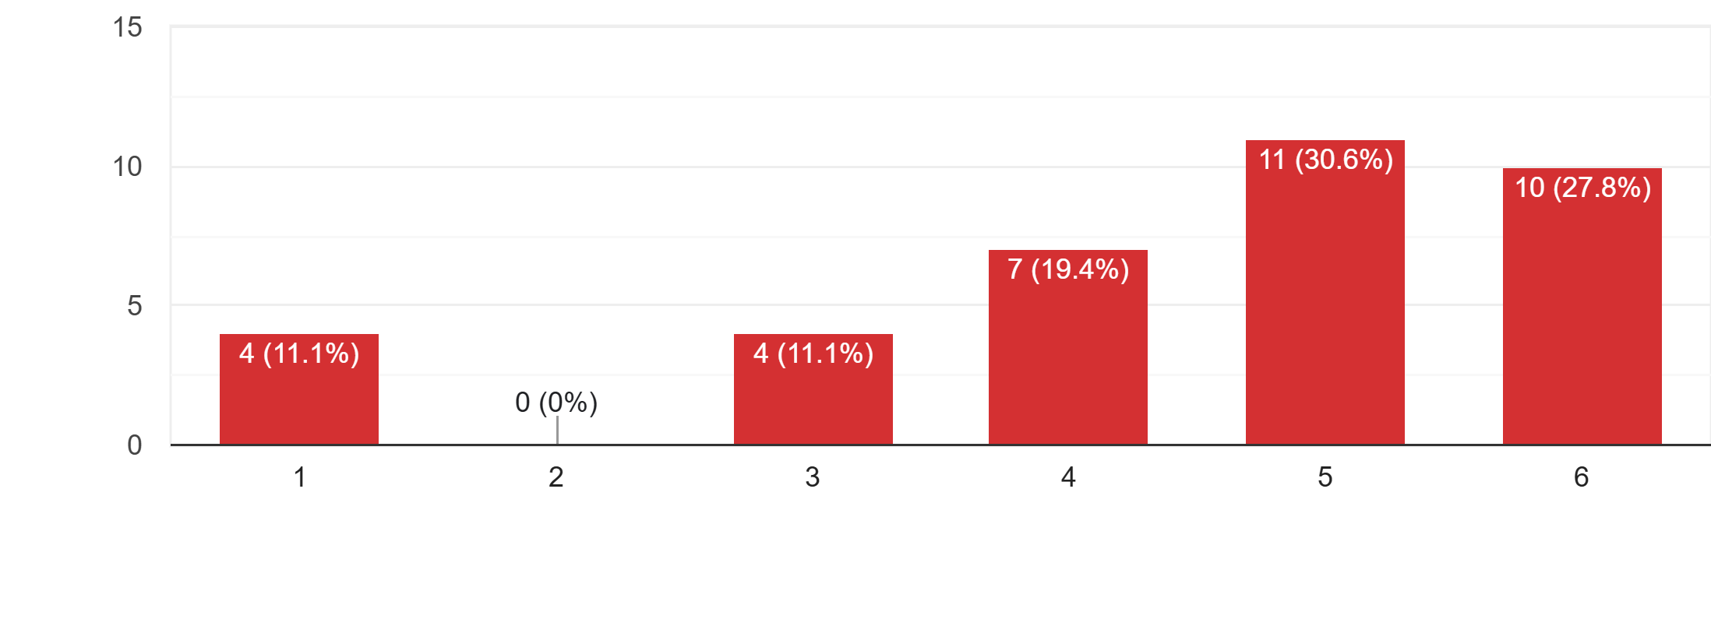
Survey Findings
Satisfaction Level with Current Streaming Services
Finding: Majority of respondents rate their satisfaction at 5 or 6 out of 6.
Insight: High satisfaction levels indicate that users generally have positive experiences with their streaming services.
Implication for Apple TV+: To compete effectively, Apple TV+ must maintain high satisfaction by focusing on quality content and user experience improvements.

Slide 8
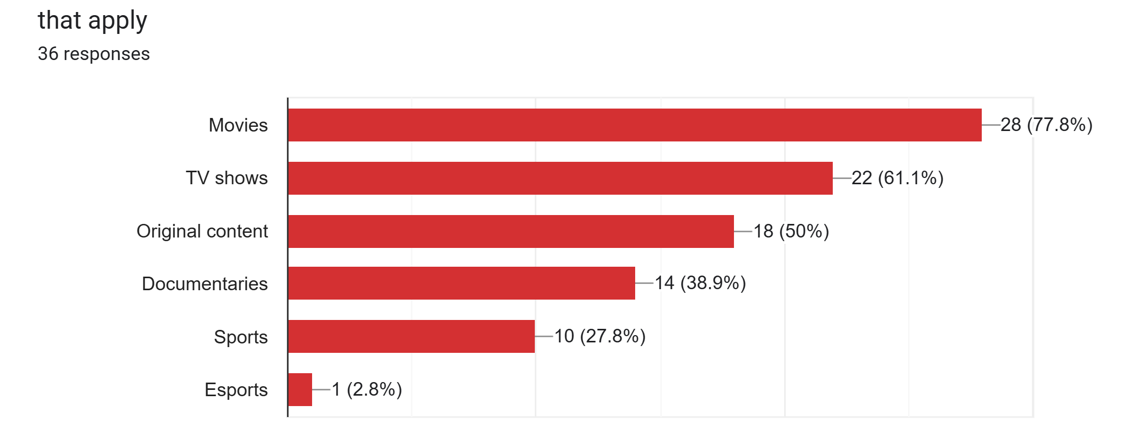
Content Preferences of Streaming Service Users
Finding: Movies (77.8%) and TV Shows (61.1%) are top choices, with Original Content at 50%.
Insight: High user interest in movies, TV shows, and exclusive original content.
Implication for Apple TV+: Expand movie and TV show offerings and continue investing in original content to meet demand.

Slide 9
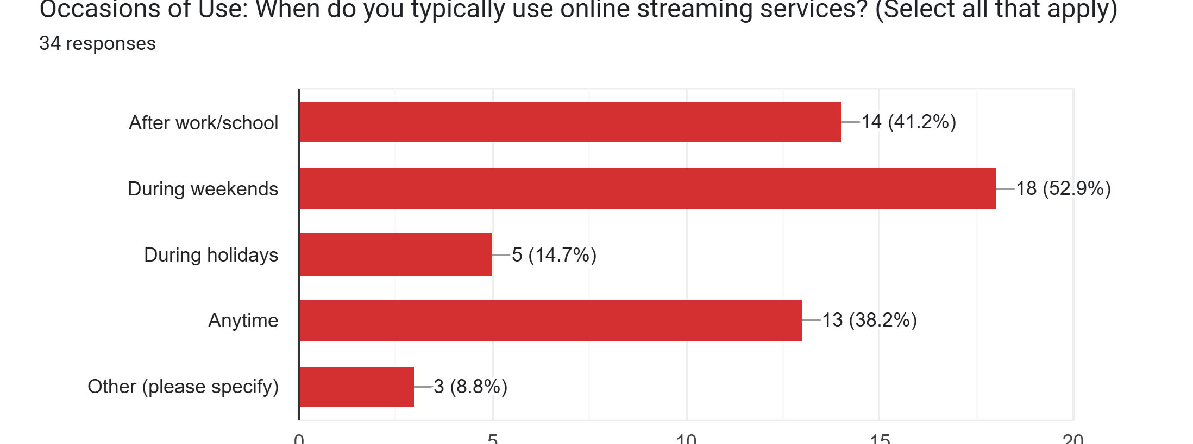
Finding: Over half of users (52.9%) stream on weekends, with strong usage after work/school and anytime.
Insight: Weekends are peak streaming times, showing a preference for leisure viewing.
Implication for Apple TV+: Focus on weekend releases and promotions to capture peak engagement.

Slide 10
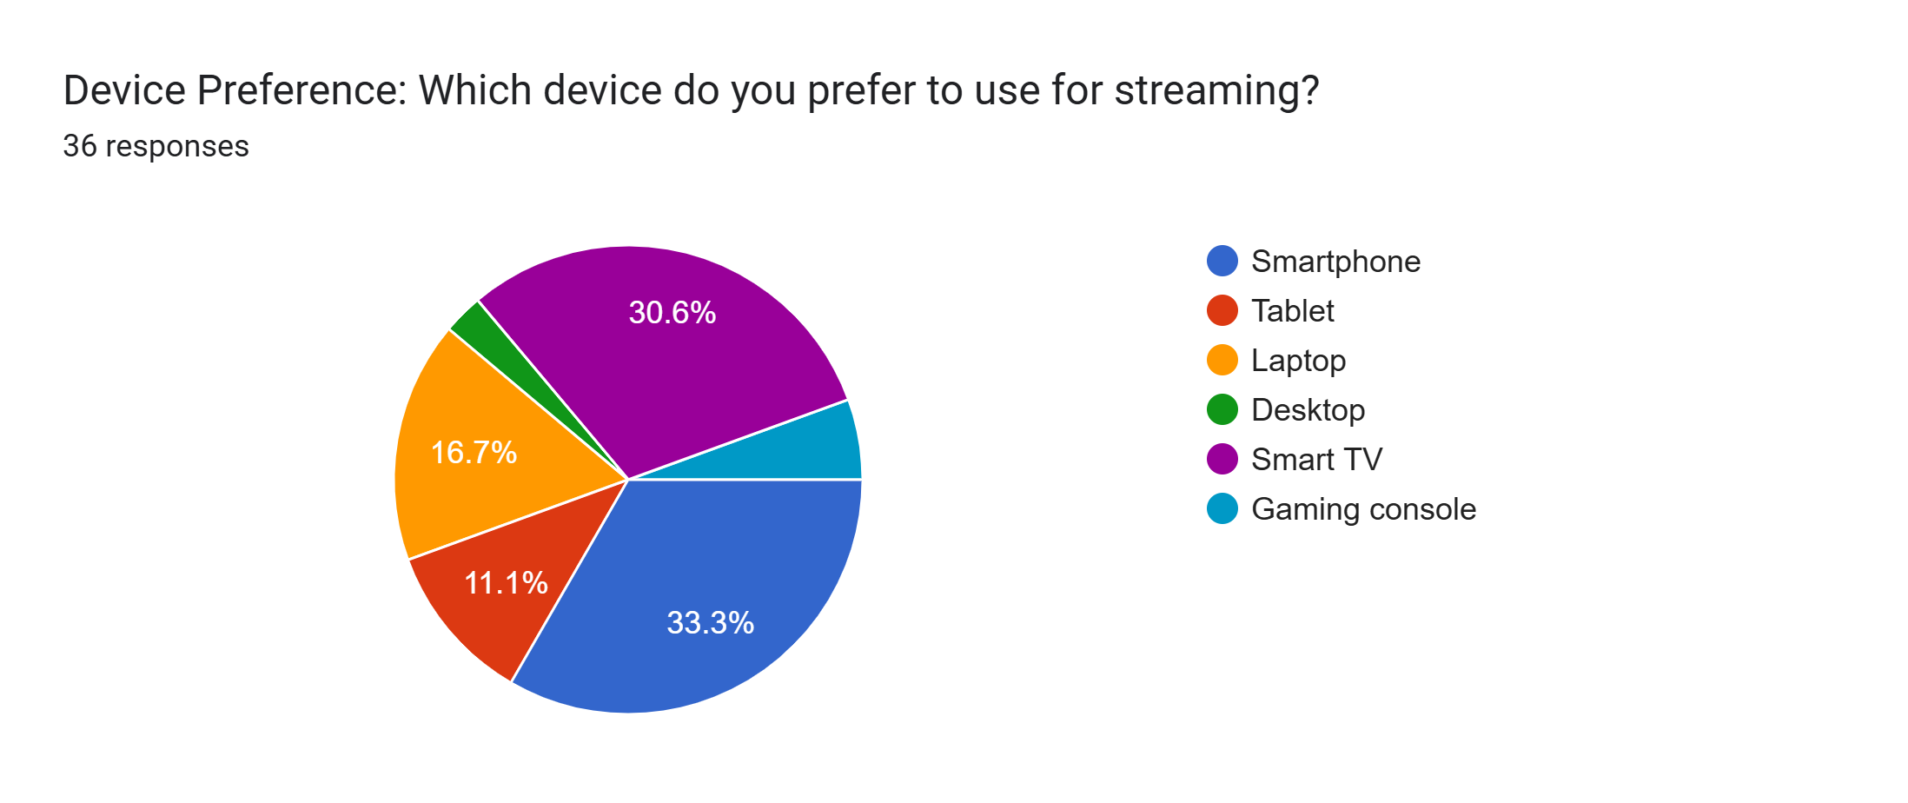
Device Preference for Streaming Services
Finding: Smart TVs (30.6%) and Smartphones (33.3%) are the top devices for streaming.
Insight: Users value large screens (Smart TVs) and convenience (Smartphones) for viewing.
Implication for Apple TV+: Prioritize high-quality streaming on both Smart TVs and Smartphones, and optimize the mobile app to engage smartphone users.

Slide 11
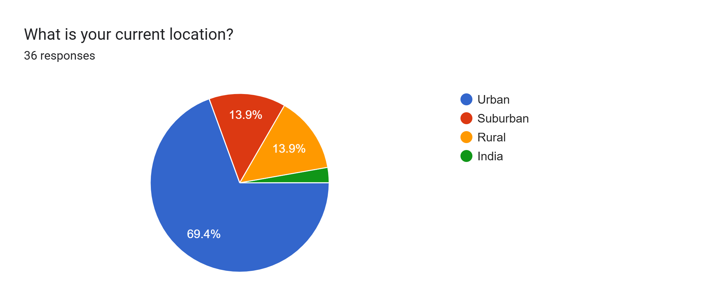
Finding: Most users (69.4%) are in urban areas.
Insight: Urban users dominate, indicating a tech-savvy, trend-focused audience.
Implication for Apple TV+: Focus marketing on urban areas with high streaming adoption and consider location-specific content for urban viewers.

Slide 12
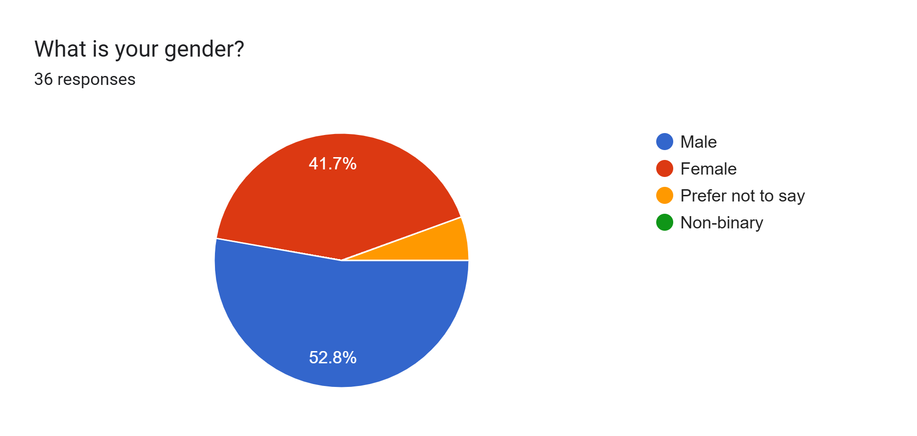

Slide 13
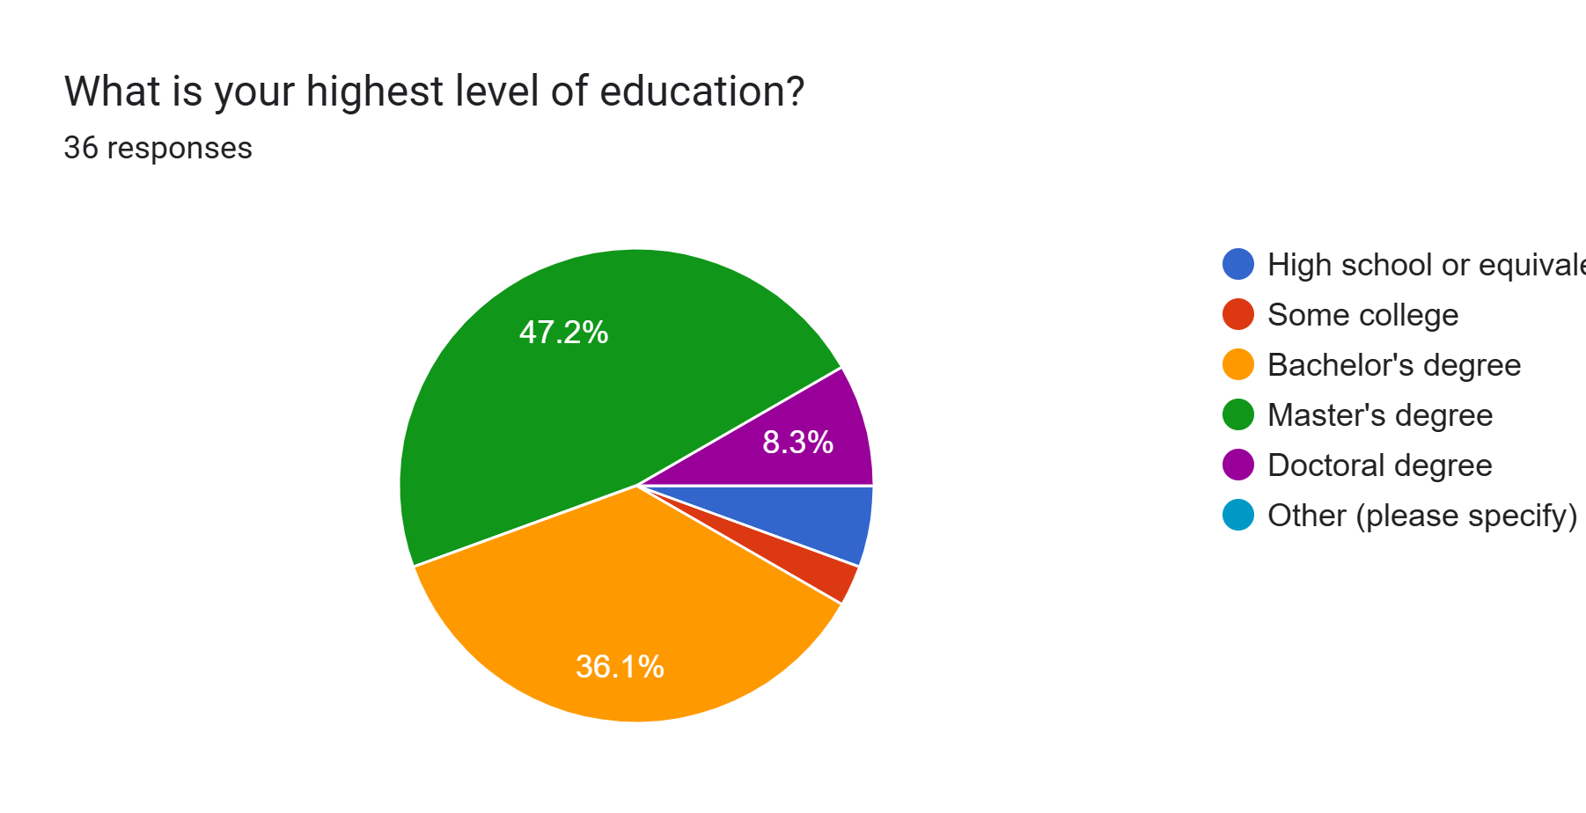

Slide 14
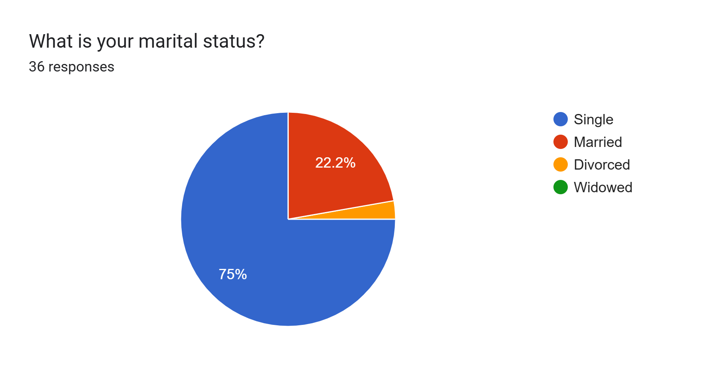

Slide 15
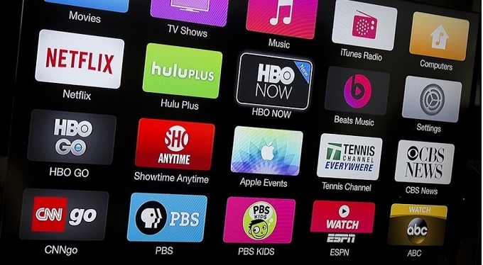
Brands
Netflix
Amazon Prime
Hulu
Paramount Plus
Disney Plus
Youtube TV
Apple TV
Cruncyroll
Tubi
Peacock

Slide 16
Attributes
Large content library
Good Streaming Quality
Low Subscription Price
High Device Compatibility
Language Restriction
Good Customer Support
Easy Searchability
No of Ads
Good User Interface
High Degree of Parental Control
No of Users per profile
Good Recommendations
Additional Features
Bundling offers
Preference

Slide 17
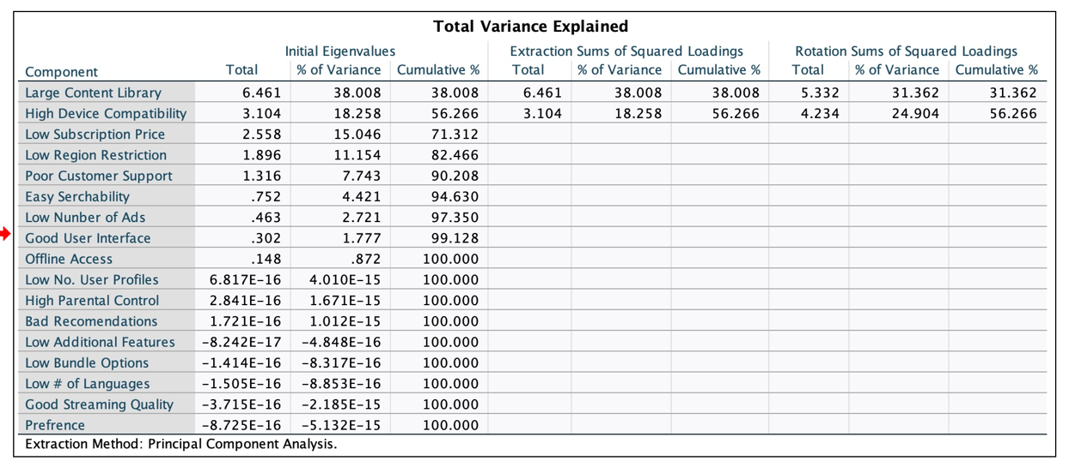
SPSS Output
Content Library, Device Compatibility, and Subscription Price make up 71% of the variance

Slide 18
User Friendly
Premium Pricing
Accessible and Affordable
Complex Viewing

Slide 19
User Friendly
Family Flicks
Content Kings
Premium Pricing
Accessible and Affordable
Pricey UX Pitfalls
Lone Video Vanguard
Complex Viewing

Slide 20
User Friendly
Premium Pricing
Accessible and Affordable
Complex Viewing

Slide 21
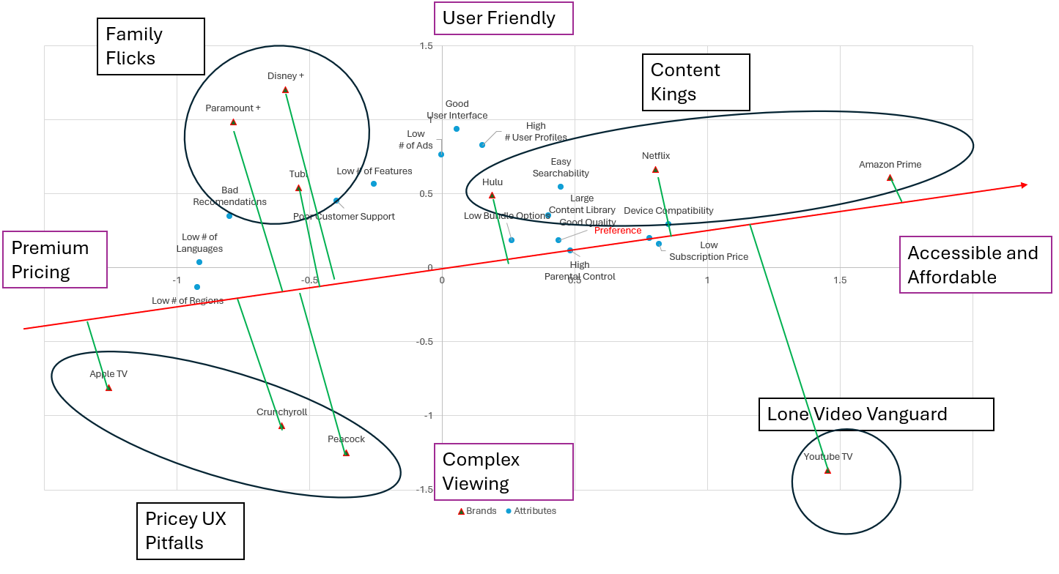
Order of Preference
1.) Amazon Prime
2.) Youtube TV
3.) Netflix
4.) Hulu
5.) Disney +
6.) Tubi
7.) Peacock
8.) Paramount +
9.) Crunchyroll
10.) Apple TV

Slide 22
User Friendly
Family Flicks
Content Kings
Premium Pricing
Accessible and Affordable
Lone Video Vanguard
Complex Viewing
Pricey UX Pitfalls

Slide 23
Family Flicks
User Friendly
5A
-Reduce Subscription Prices
-Increase Regions Available
-Increase Language Options
Content Kings
Premium Pricing
Accessible and Affordable
???? ???? ????????
Lone Video Vanguard
Complex Viewing
Pricey UX Pitfalls

Slide 24
User Friendly
5B- Increase UI Design
Family Flicks
Content Kings
Premium Pricing
Accessible and Affordable
Apple TV
Pricey UX Pitfalls
Lone Video Vanguard
Complex Viewing

Slide 25
Repositioning (5A)
Apple TV needs to increase their number of streamers by reducing their subscription price-5A
Apple TV-$10 monthly, Amazon Prime-$9 monthly, Netflix-$7 monthly
Apple TV promo for $7 a month for first 3 months
Increase perception of regions and languages available
Make more content that is based in more cultures rather than American
Do more promo of international content

Slide 26
Repositioning (5B)
Streamline the Apple TV UI to make navigation more intuitive. Key changes should include:
Clearer categorization of content.
Improved search functionality with predictive text and filters.
Reduced screen clutter to focus on high-demand content.

Slide 27
Conjoint analysis

Slide 28
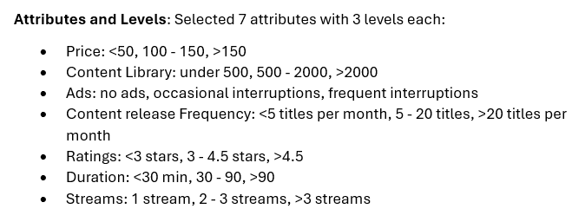
Attributes and levels

Slide 29
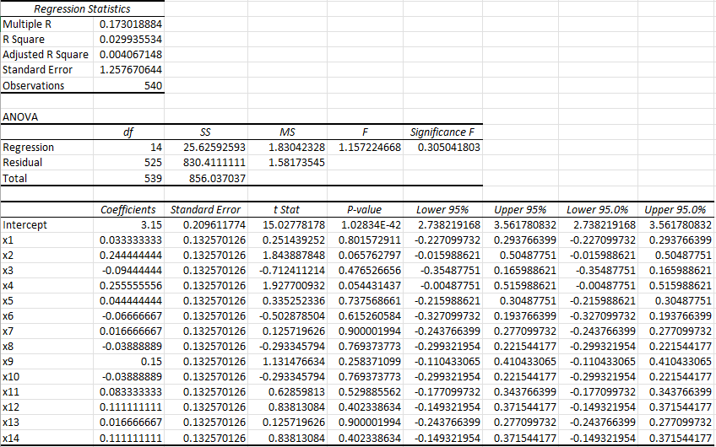
Regression output

Slide 30
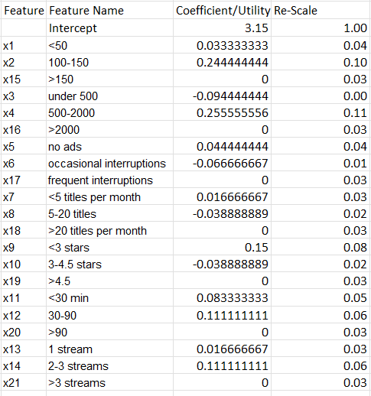
Utility Rescaling

Slide 31
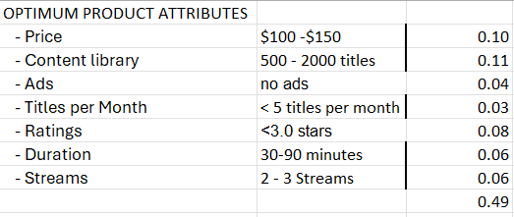
Optimum Product Attributes

Slide 32
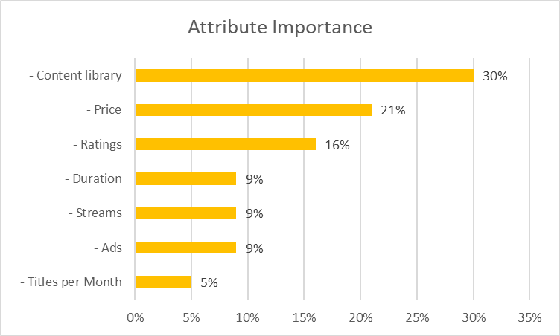
Attribute and their importance Order

Slide 34
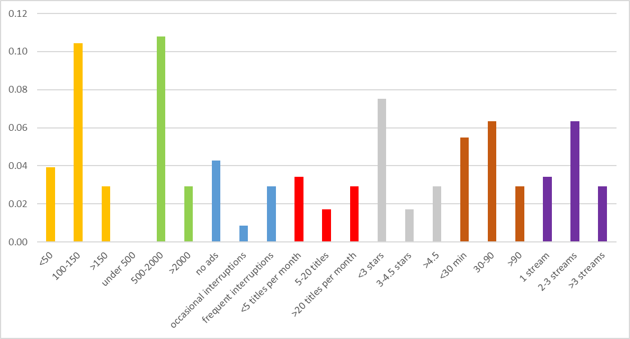

Slide 35
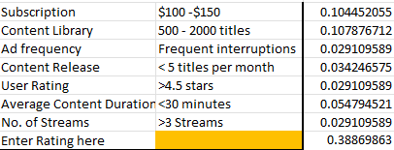
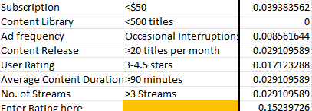
BEST AND WORST PRODUCT
High Quality Content
Low Quality Content

Slide 36
Product and its Market Share

Slide 37
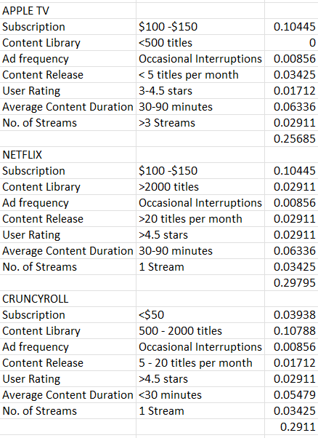
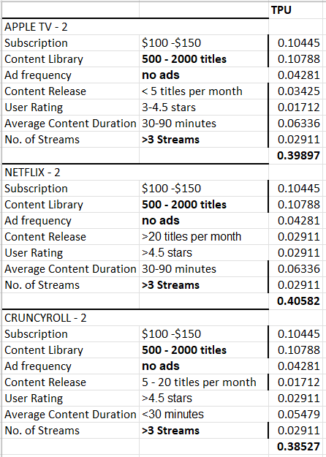

Market Simulation

Slide 38
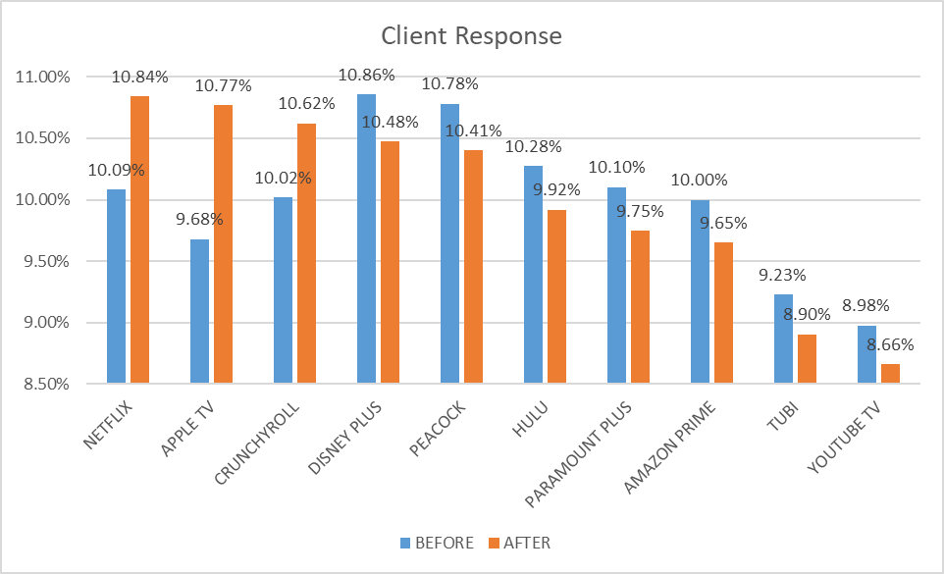
Market share after Round 1

Slide 39
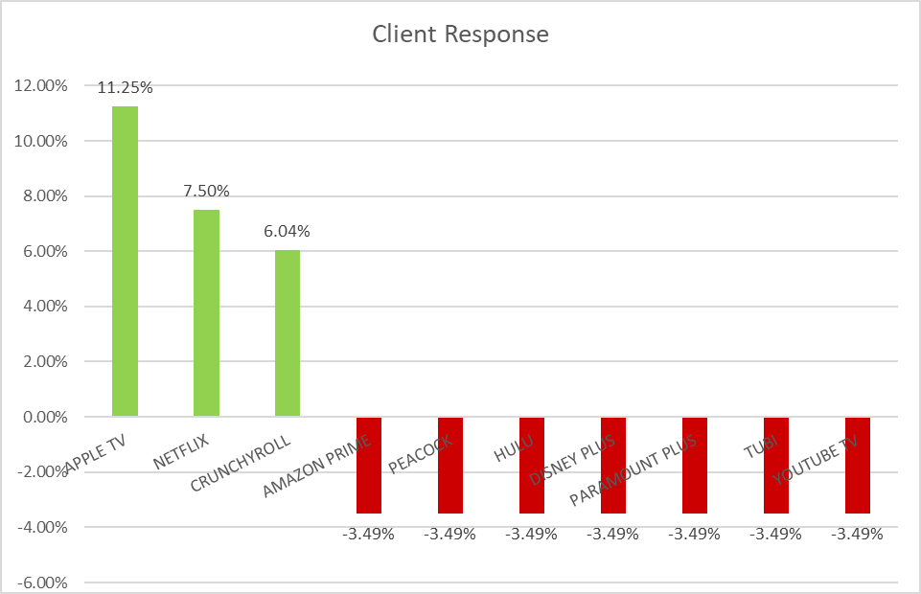

Slide 40
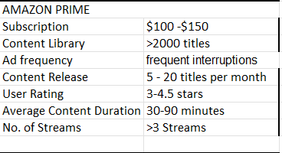
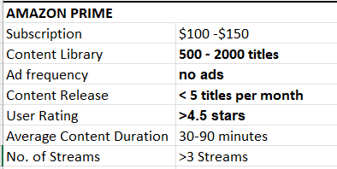
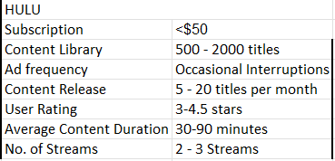
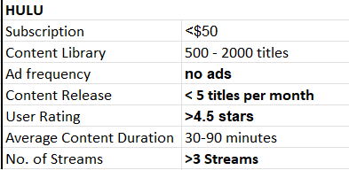
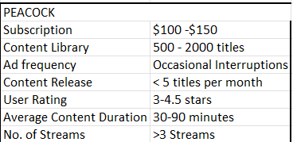
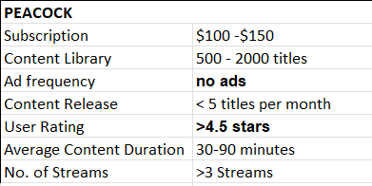
Market Simulation – 2 (Competitor's response)

Slide 41
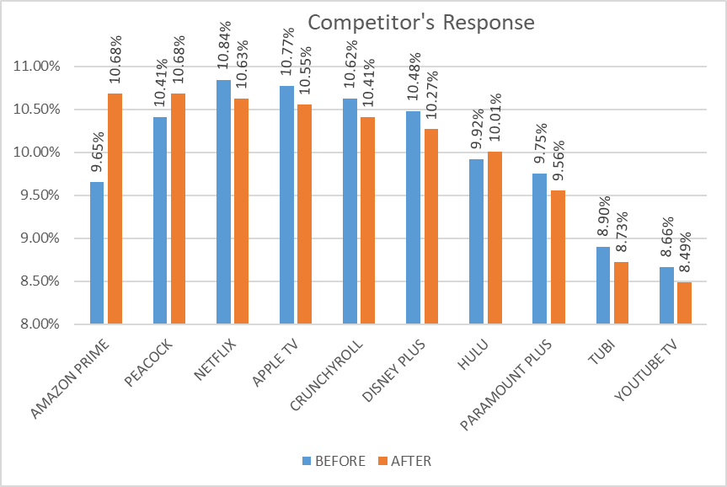
Market Share after Round 2

Slide 42
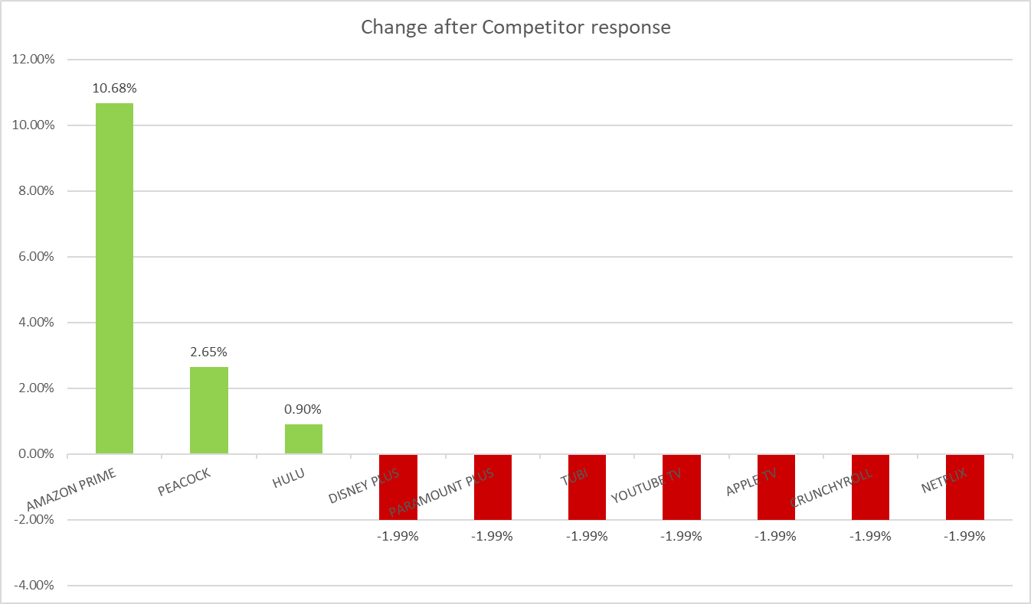

Slide 43
Changes in Market Share

Slide 44
Intercept Interpretation
We have large intercept value which typically indicate minimum acceptable product for the target market is very high.
To gain entry into market requires the product to provide high value to customers compared to the products in current market.

Slide 45
Recommendations
Product Design: Design products with the optimal attributes identified (e.g., Affordable subscription price, 500-2000 titles, no ads, less than 5 titles per month, ratings less than 3 stars, 30 - 90 minutes duration, and 2 - 3 streams).
Content Library Expansion: Invest in expanding the content library to 500 - 2000 titles to meet consumer preferences.
Ad Strategy: Implement an ad free strategy to align with consumer preferences.
Content Release Strategy: Focus on quality over quantity, releasing fewer than 5 titles per month to meet consumer preferences.
Market Positioning: Position products to provide high value to customers, given the large intercept value indicating a high minimum acceptable product standard.

Slide 46
Conclusion PM vs CA
Subscription price and quantity of content show high importance for both the PM and CA
PM and CA shows # of ads has an affect on the customer but not the most important factor
PM shows streaming quality as not important
PM-Total Variance Explained
CA-Attribute Importance

Slide 47
Summary of Recommendations
Increase
Apple TV needs to increase their number of streamers by reducing their subscription price (Strong)
Increase
Increase the amount of content to attract more streamers (Strong)
Decrease
Decrease # of ads (Strong)
Increase
Increase Language Options and perception of regions available to cater to diverse audiences (Weak)
Increase
Increase the UI accessibility with predicative text and less cluttered screens (Weak)

Slide 48
Learning Memo
Update the attributes used for Perceptual Mapping and Conjoint Analysis to have more overlap
Easier to compare results when attributes match
Change the levels of Price Attributes to free, affordable, expensive
Design of the Survey

Slide 49
APPENDIX

Slide 50
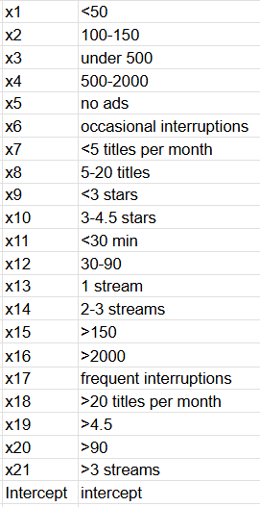
Code sheet

Slide 51
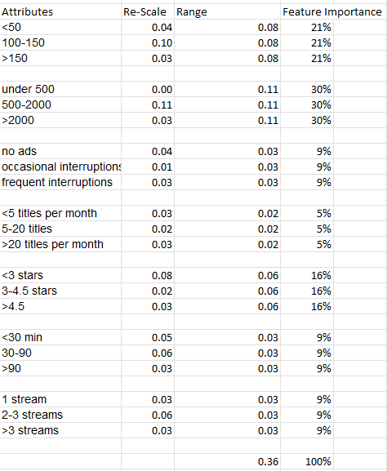
OUTPUT 2: OVERALL FEATURE IMPORTANCE CALCULATIONS

Slide 52
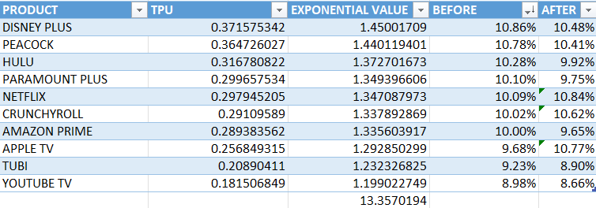
MARKET SHARE CALCULATION

